Slide 1

Sentiment Analysis of Twitter Messages Using Word2Vec
Joshua Acosta, Ezra Finkelstein, Mingxiao Luo, Norissa Lamaute and
Andreea Cotoranu
Source: http://logos-download.com/169-twitter-logo-\download.html

Slide 2
Abstract
The goal of this study is to determine whether tweets can be classified either as displaying positive, negative, or neutral sentiment using word2vec.
The challenges of applying word2vec to tweet sentiment classification include using tweet length and syntax.
The highest accuracy for sentiment classification of Twitter posts was 72%.

Slide 3
Introduction
An estimated 1.96 billion people currently use social media around the world. This figure is expected to grow to at least 2.5 billion people using social media by 2018
Through these social media applications, users freely share experiences and opinions with their network of followers. Users tend to express a variety of sentiments in their posts, therefore these posts provide invaluable insight into how the users think
Companies conduct analysis on their customers posts to determine sentiment of their products

Slide 4
Sentiment Analysis
According to the Oxford dictionary, the definition for sentiment analysis is the process of computationally identifying and categorizing opinions expressed in a piece of text, especially in order to determine whether the writer's attitude towards a particular topic, product, etc. is positive, negative, or neutral.
Sentiment analysis can provide insights into improve product messaging, determine marketing strategy, improve customer service, etc.
Source: https://www.linkedin.com/pulse/importance-sentiment-analysis-social-media-christine-day

Slide 5
Previous Research
Data Set | Accuracy | Authors
IMDB Movie Reviews | 86.40% | Pang, Lee
IMDB Movie Reviews | 88.90% | Maas, Daly, Pham, Huang, Ng, Potts
Twitter | 82.20% | Go, Bhayani, Huang
Twitter | 75.00% | Kouloumpis, Wilson, Moore
Sources: Pang, B., and Lee, L. 2008. Opinion mining and sentimentanalysis. Foundations and Trends in Information Retrieval2(1-2):1–135. Maas, A., Daly, R., Pham, P., & Huang, D. (n.d.). Learning Word Vectors for Sentiment Analysis.Proceeding HLT '11 Proceedings of the 49th Annual Meeting of the Association for Computational Linguistics: Human Language Technologies, 142-150.Go, Alec, Richa Bhayani, and Lei Huang. "Twitter sentiment classification using distant supervision." CS224N. Project Report, Stanford 1 (2009): 12. Kouloumpis, Efthymios, Theresa Wilson, and Johanna Moore. Twitter Sentiment Analysis: The Good the Bad and the OMG! in Proceedings of the Fifth International AAAI Conference on Weblogs and Social Media (ICWSM-2011). 2011.
Notes:
All Used a variety of machine learning algorithms: Primarily Support Vector Machines, Naive Bayes, and Max Entropy
-Mass built on the research of Pang and Lee by including non-word tokens (!) and emoticons :) :(
-They were able to improve the results from 86 to 89%.
-Classifcation at a sentence level which is relevant considering the short length of our texts
-Go and team used distant supervision where training data training data is labeled automatically based on heuristics / rules instead of manually by the researcher
-Kouloumpis built a dataset including hashtags (#bestfeeling, #thingsiLove, #epicFail) to collect and sort data.
-Their research compared classifcation with and without emoticons as a feature to see the value of including them
-Important to note that it is hard to compare the accuracies because they are all on different datasets.
-Movie reviews were much longer and therefore should be easier to classify
5

Slide 6
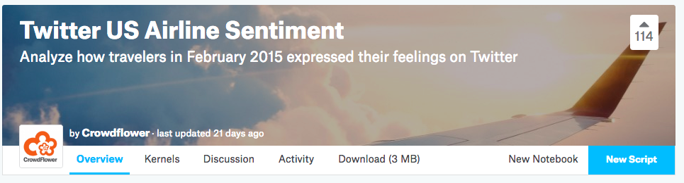
Kaggle Dataset
Source: Kaggle.com
Notes:
I downloaded the dataset from Kaggle which was originally from Crowdflower’s Data for Everyone
In order to study the sentiment of Twitter data, we collected a Kaggle dataset of tweets relating to user’s experiences with U.S airlines. The dataset contains 14,640 tweets and 15 attributes including the original tweet text, Twitter user-related data and the class sentiment label.
https://www.crowdflower.com/data-for-everyone/
6

Slide 7

Methodology
Dataset training and testing split 70/30
Pre-processed data by removing HTML links, tokenizing words in the tweet and making all characters lowercase
Created 300-dimentional vectors using arrays
Scaled vectors in order to feed into classifier
Trained two word2vec models, Skip-Gram and Continuous Bag-of-Words

Slide 8
Exploratory Data Analysis
Notes:
In order to analysis sentiment of the tweets, we used scikit-learn’s train_test_split function to split the tweets and it sentiment label 70% for training and 30% for testing purposes
8

Slide 9
Exploratory Data Analysis (Continued)
Notes:
Before training machine learning models on the data, we conducted some exploratory data analysis on the dataset to get a better understanding of what it entailed.
Image includes the number of tweets by sentiment by airline.
9

Slide 10

Gensim
Source: https://radimrehurek.com/gensim/
Notes:
We used the Gensim word2vec implementation written in Python.
The genism word2vec library was instantiated using the sentences created and configured parameters such as number of vector vector dimensionality features, context window size around words and minimum word count of words before they are included in the model. Once the word2vec model created word embeddings, we created features by averaging the word vectors. The new vectors were then used to instantiated a Linear Support Vector Machine classifier and the initial result was recorded.
10

Slide 11
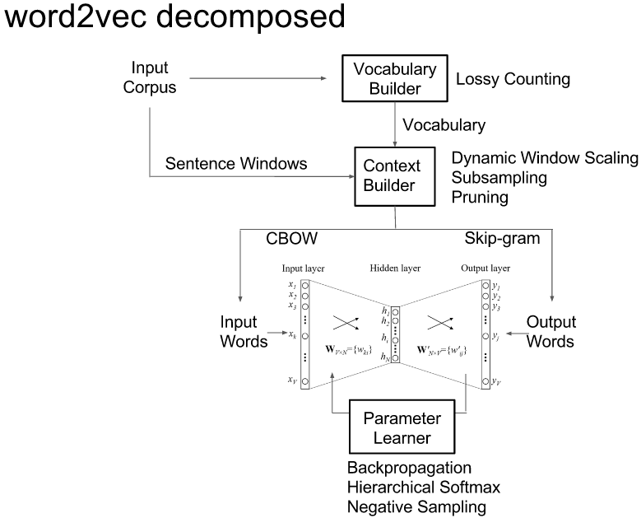
Word2vec
Source: Xin Rong – University of Michigan
Notes:
11

Slide 12
Preliminary Results
Classifier | Training Model | Accuracy %
Gaussian Naive Bayes | CBOW | 63
Bernoulli Naive Bayes | CBOW | 63
Support Vector Classifier | CBOW | 63
Logistic Regression | CBOW | 63
Gaussian Naive Bayes | Skip-Gram | 63
Bernoulli Naive Bayes | Skip-Gram | 63
Support Vector Classifier | Skip-Gram | 63
Logistic Regression | Skip-Gram | 63
Notes:
Preliminary results classified 63% tweets correctly.
Example the different classifiers used using scikit-learn.
12

Slide 13
Preliminary Results (continued)

Slide 14
Handling Imbalance
Random Oversampling – duplicating minority classes until balanced with majority class
Source: http://contrib.scikit-learn.org/imbalanced-learn

Slide 15
Experimental Results
Classifier | Training Model | Accuracy %
Gaussian Naive Bayes | CBOW | 64
Bernoulli Naive Bayes | CBOW | 56
Support Vector Classifier | CBOW | 70
Logistic Regression | CBOW | 69
Gaussian Naive Bayes | Skip-Gram | 69
Bernoulli Naive Bayes | Skip-Gram | 62
Support Vector Classifier | Skip-Gram | 72
Logistic Regression | Skip-Gram | 72

Slide 16
Classification Report of Logistic Regression Classifier
 | Precision | Recall | F1-score | Support
Negative | 0.87 | 0.75 | 0.81 | 2750
Neutral | 0.51 | 0.62 | 0.56 | 936
Positive | 0.57 | 0.70 | 0.63 | 706
Average / Total | 0.75 | 0.72 | 0.73 | 4392

Slide 17
Classification Report of Support Vector Classifier
 | Precision | Recall | F1-score | Support
Negative | 0.87 | 0.76 | 0.81 | 2750
Neutral | 0.52 | 0.63 | 0.57 | 936
Positive | 0.59 | 0.70 | 0.64 | 706
Average / Total | 0.75 | 0.72 | 0.73 | 4392

Slide 18
Conclusions/Future Work
By using the word embeddings, we avoid having to manually create features (using stylometry, Parts-of-Speech tagging, etc.) in order to classify correctly
Accuracy improved when sampling technique implemented for imbalanced classes
Tweet length, syntax and improper grammar are still limiting
Testing other sampling techniques including SMOTE and ADASYN to improve accuracy
Notes:
18

